Slide 1

Developer Salary
Prediction
Model
REGRESSION
TEAM 4- [GPS]

Slide 2

PROBLEM STATEMENT
Build a machine learning model to accurately predict developer salaries based on experience, skills, and job profile data.

Slide 3
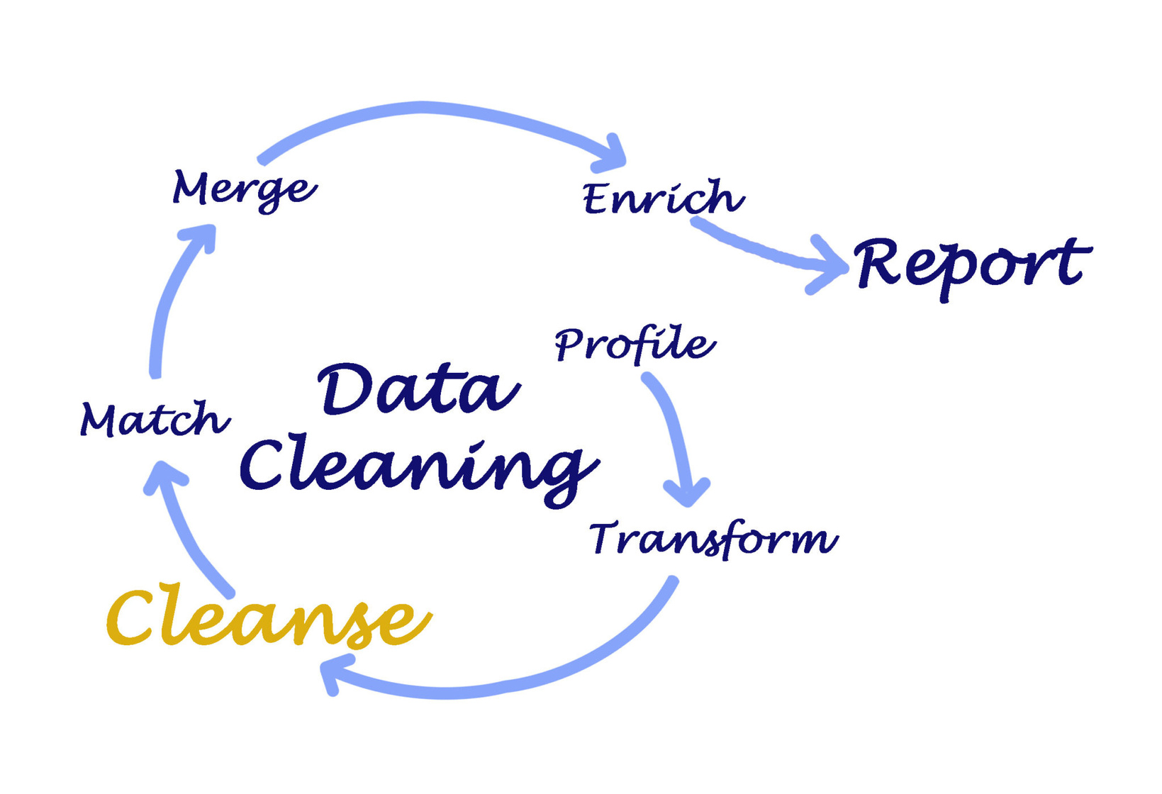

1st
DATA CLEANING
🔹 Objective:
To remove irrelevant, missing, or inconsistent data to improve model performance.
✅ HOW WE DONE IT:
Dropped Irrelevant Columns Columns like LearnCode, TechList, BuyNewTool, and others not contributing to prediction were removed.
Removed Rows with Missing Salary Rows without a valid ConvertedCompYearly (target) were dropped.
Filtered for Full-Time Employees Only Ensured consistency by keeping only Full-time entries in Employment.
Source: Stack Overflow Developer Survey

Slide 4
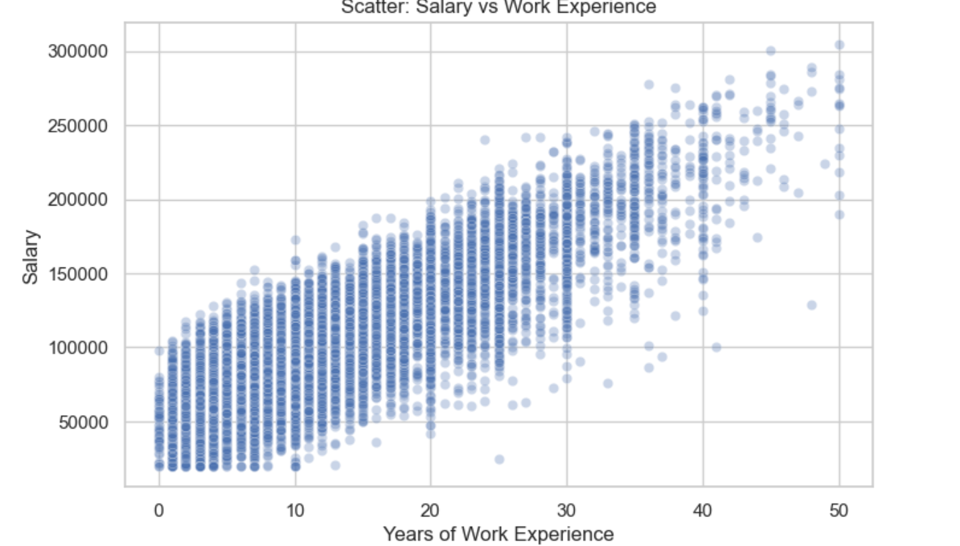
Exploratory Data Analysis
🔹 Objective 🔹
To understand the data distribution, identify key patterns, and detect anomalies before modeling.
✅LET US SEE,HOW WE DONE IT:
Positive Correlation:
The graph shows an upward trend — as years of work experience increase, salary also tends to increase.
This suggests that more experienced individuals generally earn higher salaries.

Slide 5
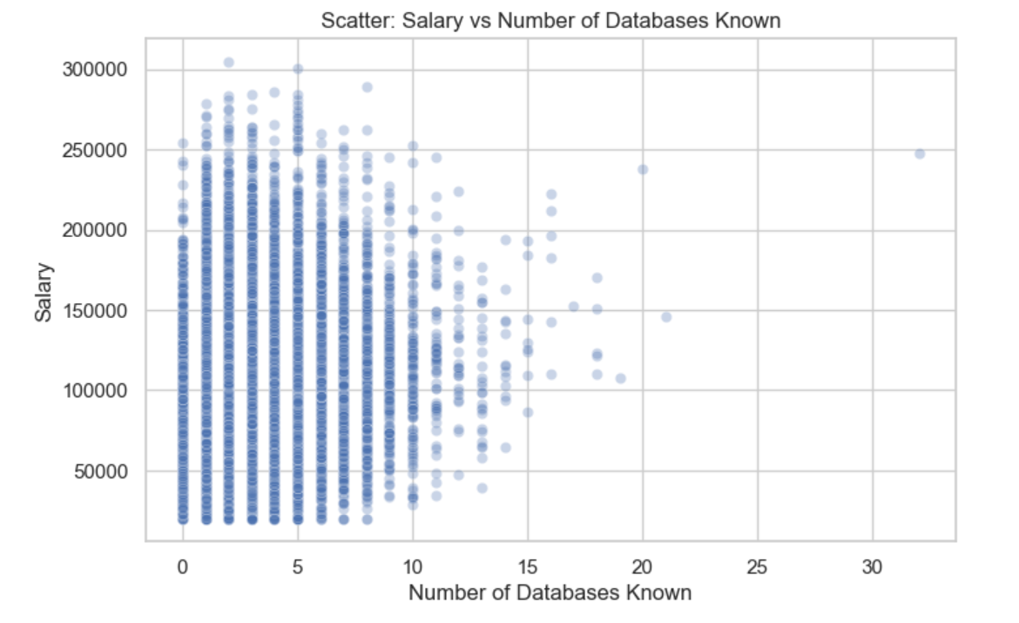
🔍 Interpretation:
No strong correlation is visible here.
High density around 0–10 databases.
Salaries don’t necessarily increase with more databases known.

Slide 6
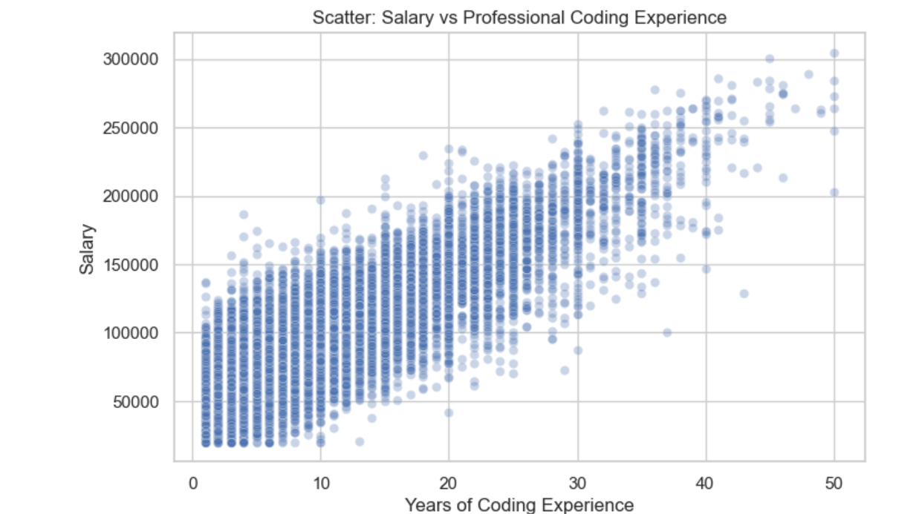
🔍 Interpretation:
Strong positive correlation.
Salaries tend to increase with more years of professional coding experience.
Similar to general work experience, but even more tightly clustered with a clearer upward trend.

Slide 7
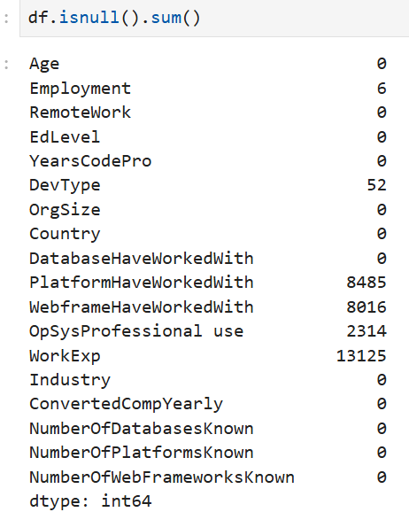
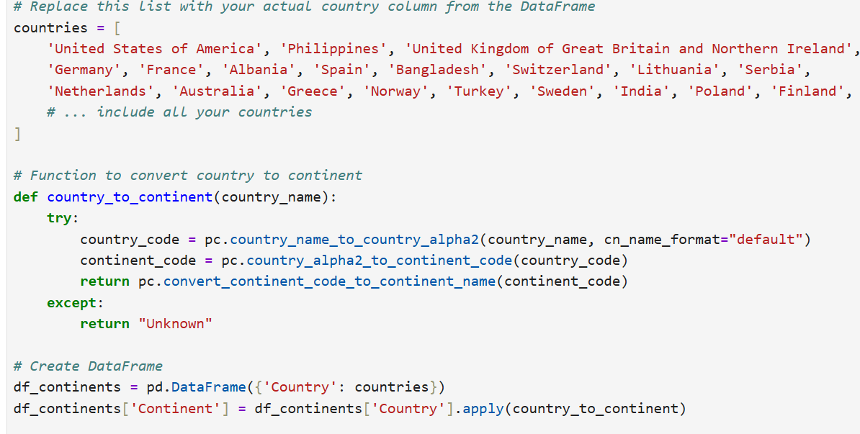
1.Selected Relevant Features
2.Encoded Categorical Features
3.Normalized Experience Data
4.Grouped Rare Categories
Feature Engineering

Slide 8
Regression Models Are Used
🔍 Why is it a Regression Model?
✅ 1. Continuous Output (Target Variable)
The output (salary) is a continuous numerical value, not a category.
Example:
Predicting ₹95,000 or ₹1,50,000 — these are numerical values on a scale, not discrete classes.
✅ 2. Goal: Predict Quantitative Value
Regression models are used when the goal is to estimate or predict "how much" or "how many".
Here, you're predicting "how much salary" someone will earn.

Slide 9
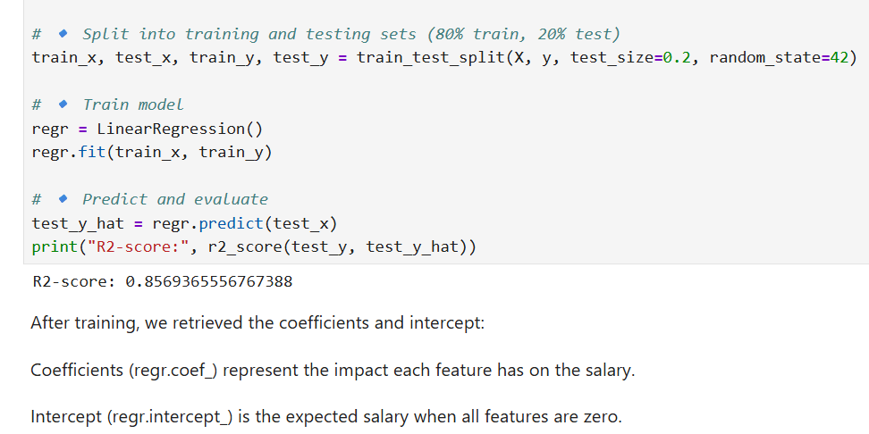
1. Linear Regression
✅ Simple, Interpretable Model
Assumes a linear relationship between features (e.g., experience, databases known) and the target (salary).
Fits a straight line:
Salary=β0+β1⋅Experience+β2⋅Coding Exp+....
🔹 Pros:
Very fast to train.
Easy to interpret and explain.
Works well when relationships are linear.
🔻 Cons:
Performs poorly with non-linear data or complex feature interactions.
Sensitive to outliers and multicollinearity.

Slide 10
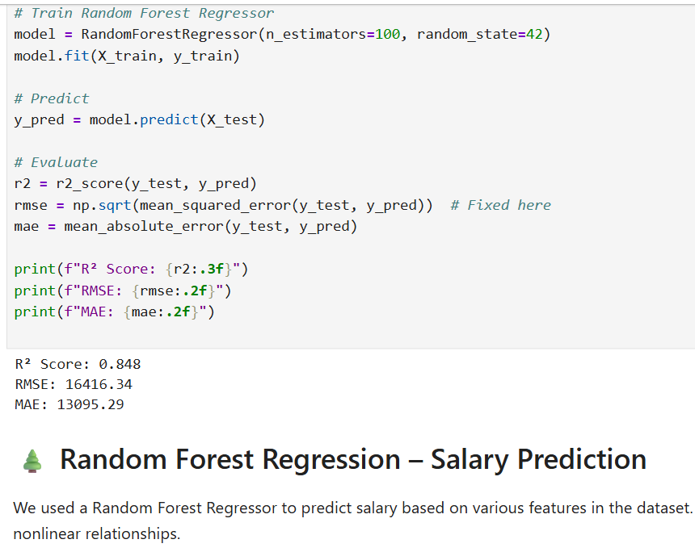
🌲 2. Random Forest Regressor
✅ Ensemble of Decision Trees
Combines many decision trees trained on different data subsets.
Each tree makes a prediction, and the final output is the average of all.
🔹 Pros:
Handles non-linear patterns and feature interactions well.
More robust to outliers and noise.
Performs better than linear models on complex data.
🔻 Cons:
Less interpretable.
Training is slower than linear models.
Slightly less accurate than XGBoost in many cases.

Slide 11
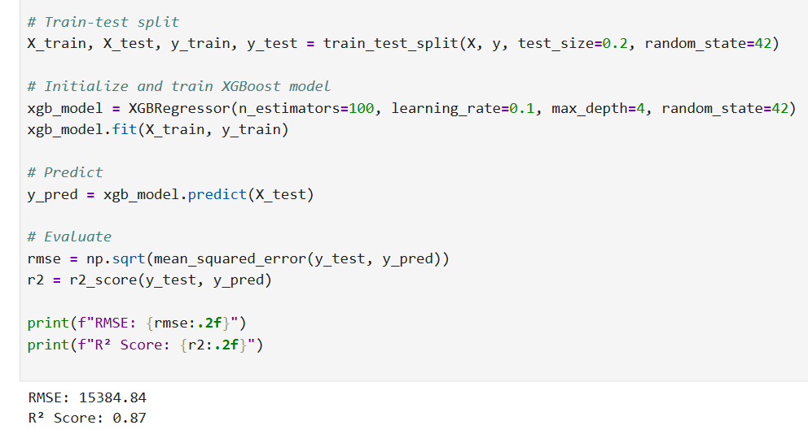
⚡ 3. XGBoost Regressor ✅)
⚡ 3. XGBoost Regressor (Best Performa✅ Extreme Gradient Boosting
An advanced tree-based algorithm that builds trees sequentially, learning from previous errors.
🔹 Pros:
High performance: Often the best model in real-world regression tasks.
Handles missing values, outliers, and feature interactions automatically.
🔻 Cons:
More complex to tune (hyperparameters).
Requires more computing power.

Slide 12


🎯 Why We Used XGBoost in Our Salary Prediction Model
🔑 Model-Specific Reasons:
🏆 Best Performance on Our Data
Among Linear Regression, Random Forest, and XGBoost — XGBoost achieved the highest R² score and lowest RMSE during testing.
📈 Captures Complex Patterns
Salary depends on non-linear interactions (e.g., coding experience may matter more after a certain threshold).
XGBoost automatically learns such non-linear trends.
🧠 Smart Regularization
Helps avoid overfitting, even though salary data can be noisy or have outliers.
Built-in L1/L2 regularization gave our model better generalization.
📊 Interpretable Feature Importance
We used XGBoost to analyze which features most strongly influence salary, adding insight to our predictions.

Slide 13
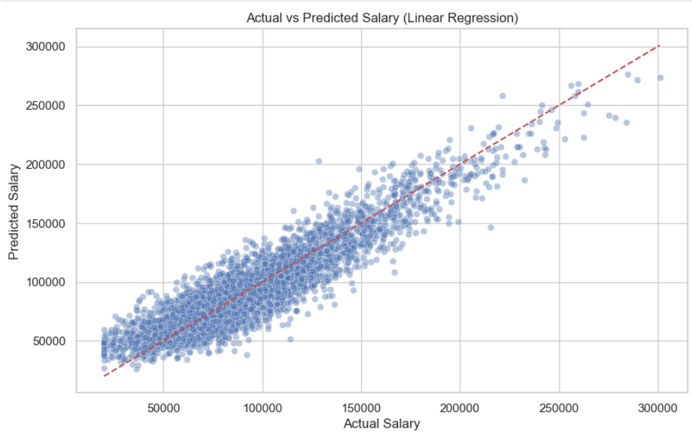
“This graph compares actual salaries with predicted ones from our Linear Regression model. The clustering around the diagonal line shows that the model captured the salary trends well, though more advanced models like XGBoost offered even better accuracy.”

Slide 14

“Most predictions are close to actual values, proving our model is both accurate and trustworthy.”
Thank you!

